Slide 1

Isolation Shed
Elvis has left the building ...

Slide 2
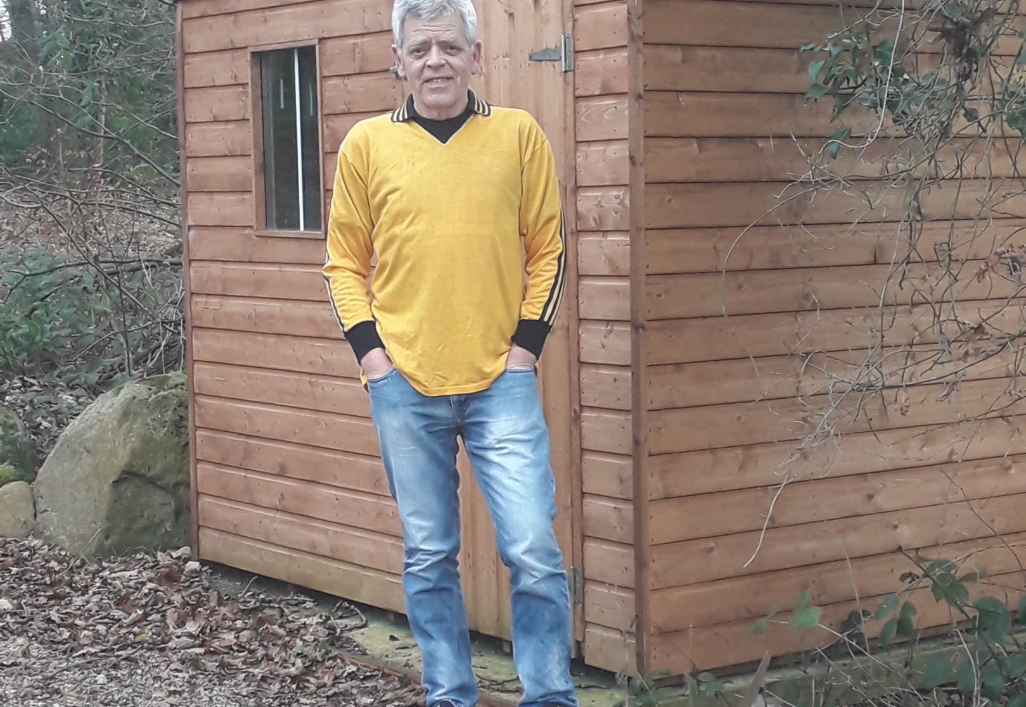
Isolation Blues
Woke up this morning, got those my family kicked me out and sent me to live in this isolation shed with the en-suite behind it and the dodgy wifi-connection lockdown isolation blues!

